Slide 1
INVESTMENT CASE STUDY SUBMISSION
Group Name:
Abinash Bishoyi
Karthik Vecham
Balaji Nagaraja

Slide 2
Spark Fund Business Objective
Business Objective:
Identify the best sectors, countries, and a suitable investment type for making investments.
Invest where others are investing, implying that the best sectors and countries are the ones where most investments are happening.
Constraints:
Invest between 5 to 15 million USD per round of investment
Invest only in English-speaking countries because of the ease of communication

Slide 3
Analysis Methodology
Data Understanding and Preparation
Data Analysis
Data Visualization
Data
Source
companies.txt
rounds2.csv
Data Cleaning
Merge Dataset
Data Cleaning
Feature Addition
Sector Mapping
mapping.csv
Investment Type
Country
Sector
Analysis
Analysis
Funding Round Type - Total & Average Investments
Top 9 Countries Total Investments
Total Investments with Top 3 Sectors of Top 3 Countries

Slide 4
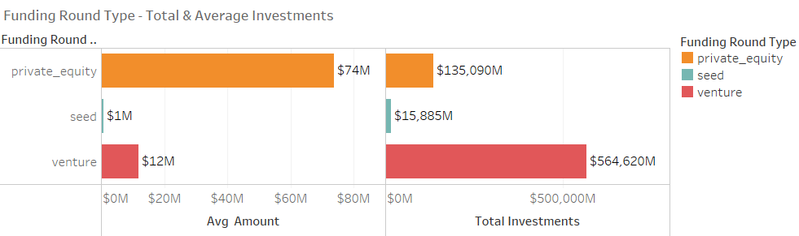
Funding Type Analysis
Based on the above analysis we concluded that “Venture” type will best suit for Spark Fund.

Slide 5
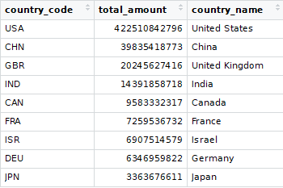
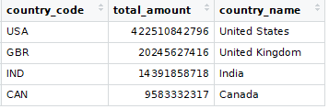
Country Analysis
English Speaking Country
Based on above analysis, out of top 9 (shown) top 3 English speaking countries
1stCountry : USA
2ndCountry : United Kingdom
3rdCountry : India

Slide 6
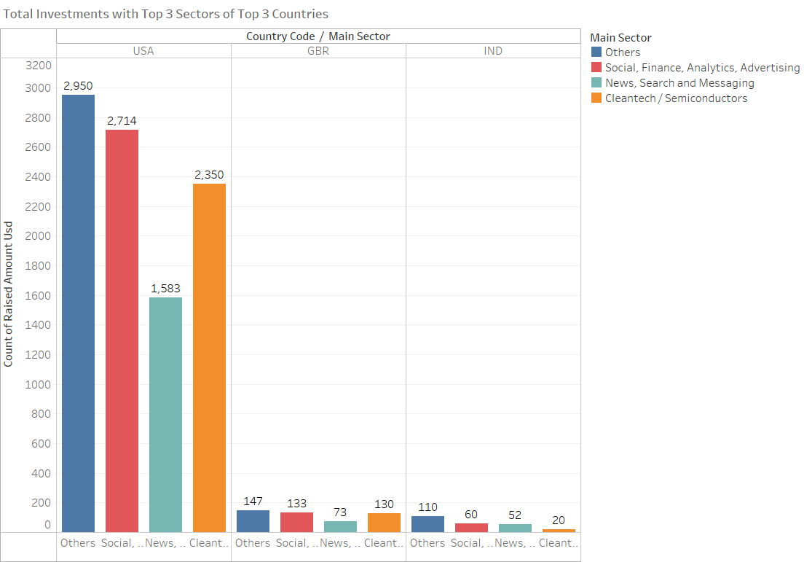
Sector Analysis
Country with highest investment: USA
Top Sector : Others
2nd Top Sector: Social, Finance, Analytics
3rd Top Sector: Cleantech/Semiconductors
Country with 2nd highest investment: United Kingdom
Top Sector: Others
2ndTop Sector: Social, Finance, Analytics
3rdTop Sector: Cleantech/Semiconductors
Country with 3rd highest investment: India
Top Sector: Others
2nd Top Sector: Social, Finance, Analytics
3rd Top Sector: News, Search, Messaging

Slide 7
Funding Round Type - Total & Average Investments

Slide 8
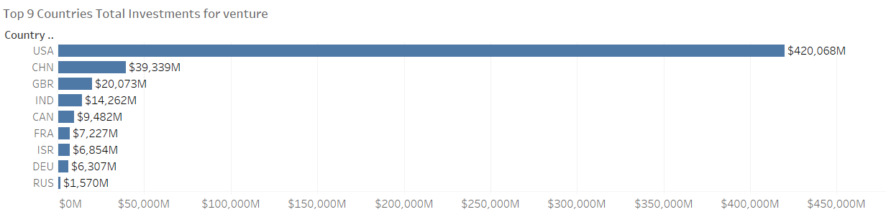
Top 9 Countries Total Investments
Plot 2

Slide 9
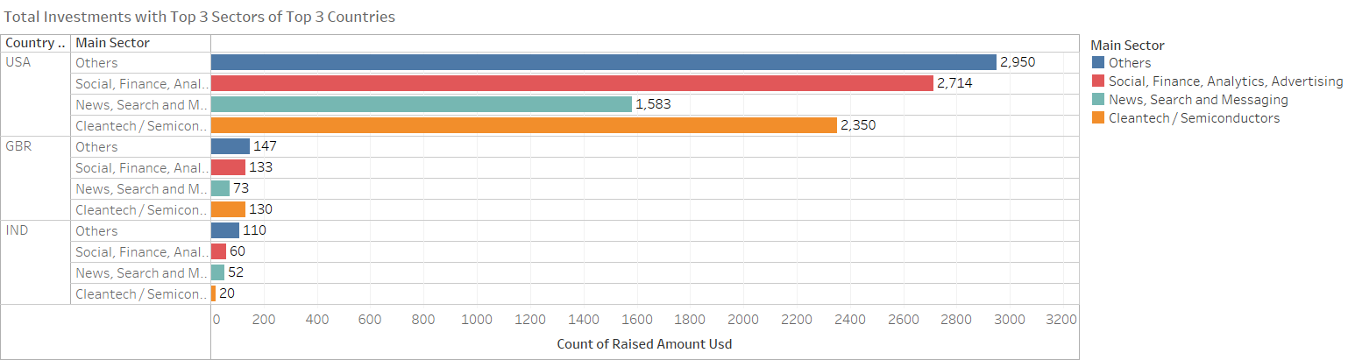
Total Investments with Top 3 Sectors of Top 3 Countries

Slide 10
Conclusions
Based on analysis, Spark fund should invest in the following countries:
Country | Investment Sector
USA | Others Social, Finance, Analytics, Advertising Cleantech / Semiconductors
United Kingdom | Others Social, Finance, Analytics, Advertising Cleantech / Semiconductors
India | Others Social, Finance, Analytics, Advertising News, Search and Messaging

